Slide 1


DS2500 - Final Presentation
DK Lee (u1326445)

Slide 2
QUESTION
After I changed, new question is…
Does a team’s performance of first half season lead them to the championship?
Reasons:
Prev Question:
Does a team's performance on the group stage lead them to the championship?
Reasons:
How hard is the league (UEFA league ranking)
How are they doing in league (league point ratio)
GOOD Performance on UCL Group Stage
GOOD Performance on UCL Group Stage
GOOD Performance in their league
GOOD Performance on UCL Tournament
GOOD Performance on UCL Tournament
CHAMPIONS!!
CHAMPIONS!!

Slide 3
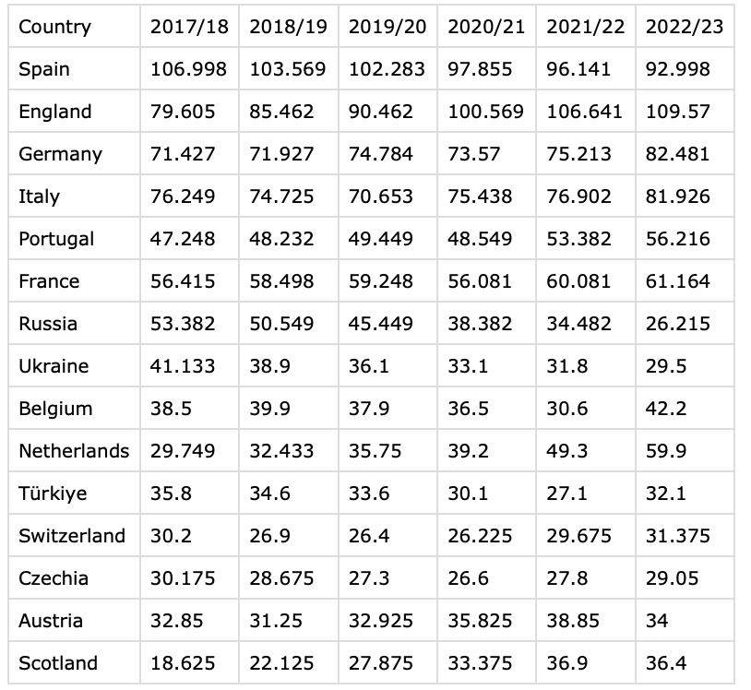
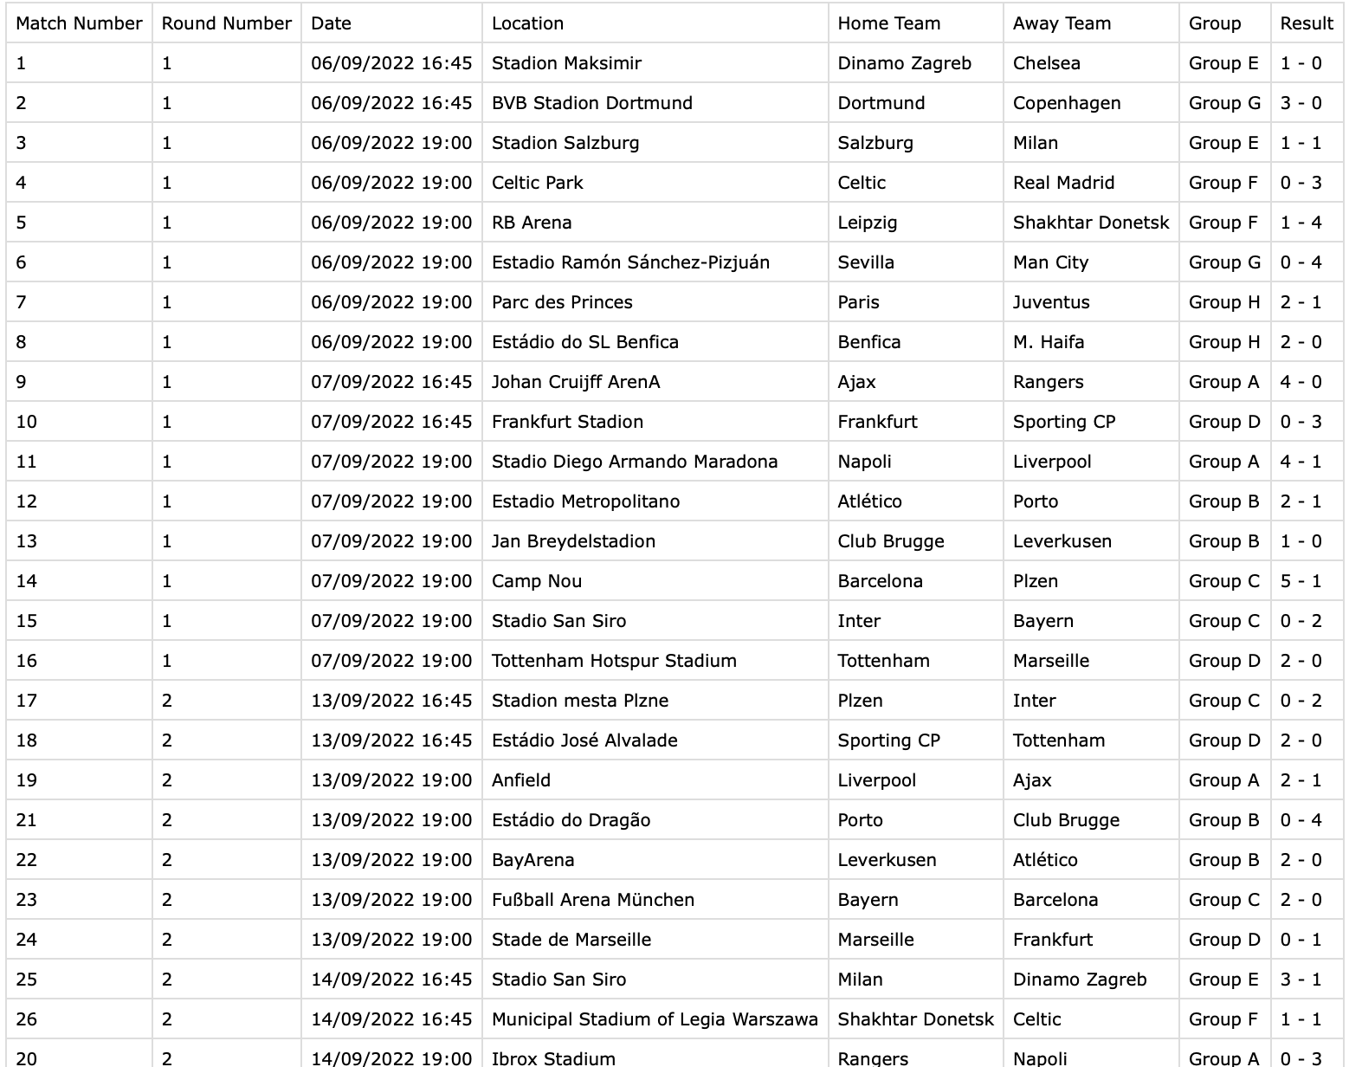
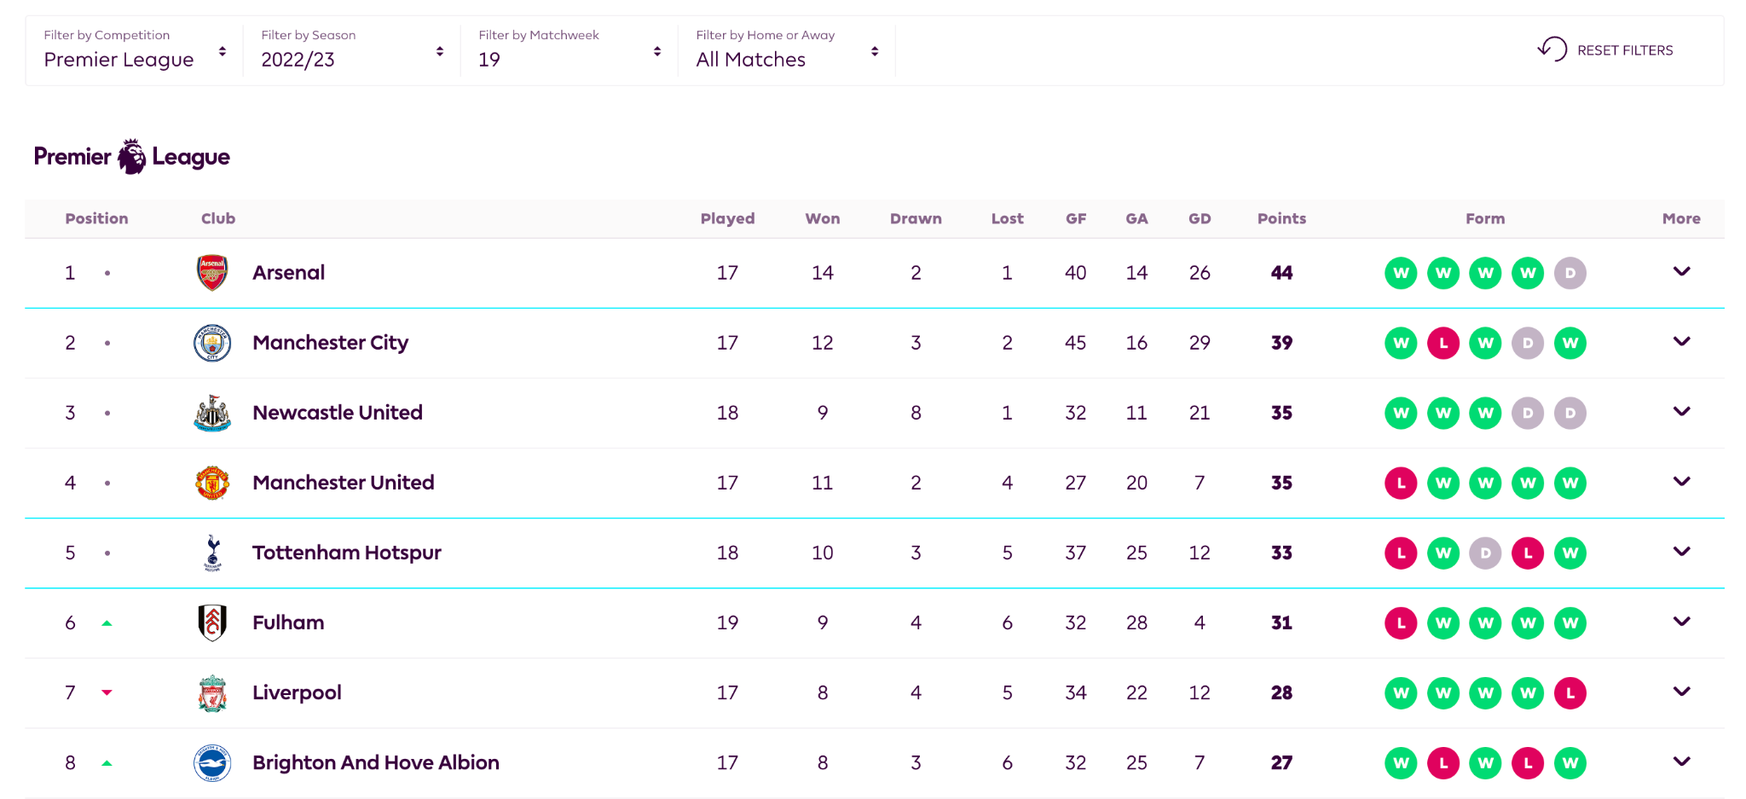
DATA
UEFA League Ranking from 2017 to 2022 season
Example of EPL Half of the 2022 Season League Table
Example of UCL Season Group Stage Match Info(2022/23)

Slide 4
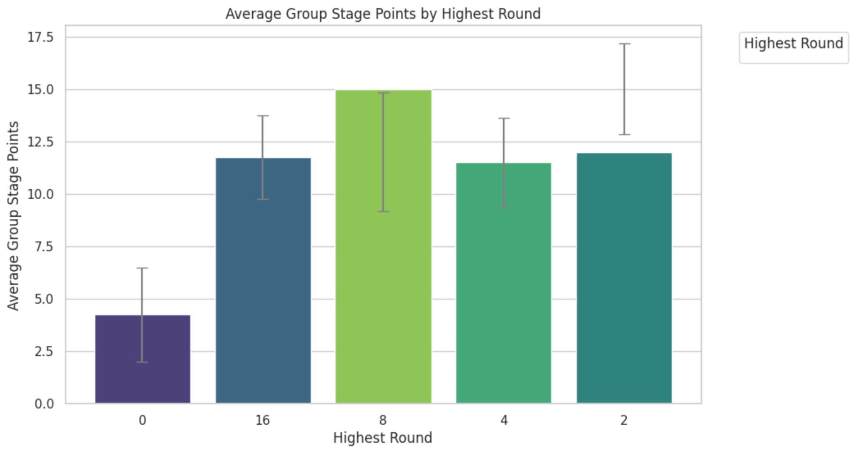
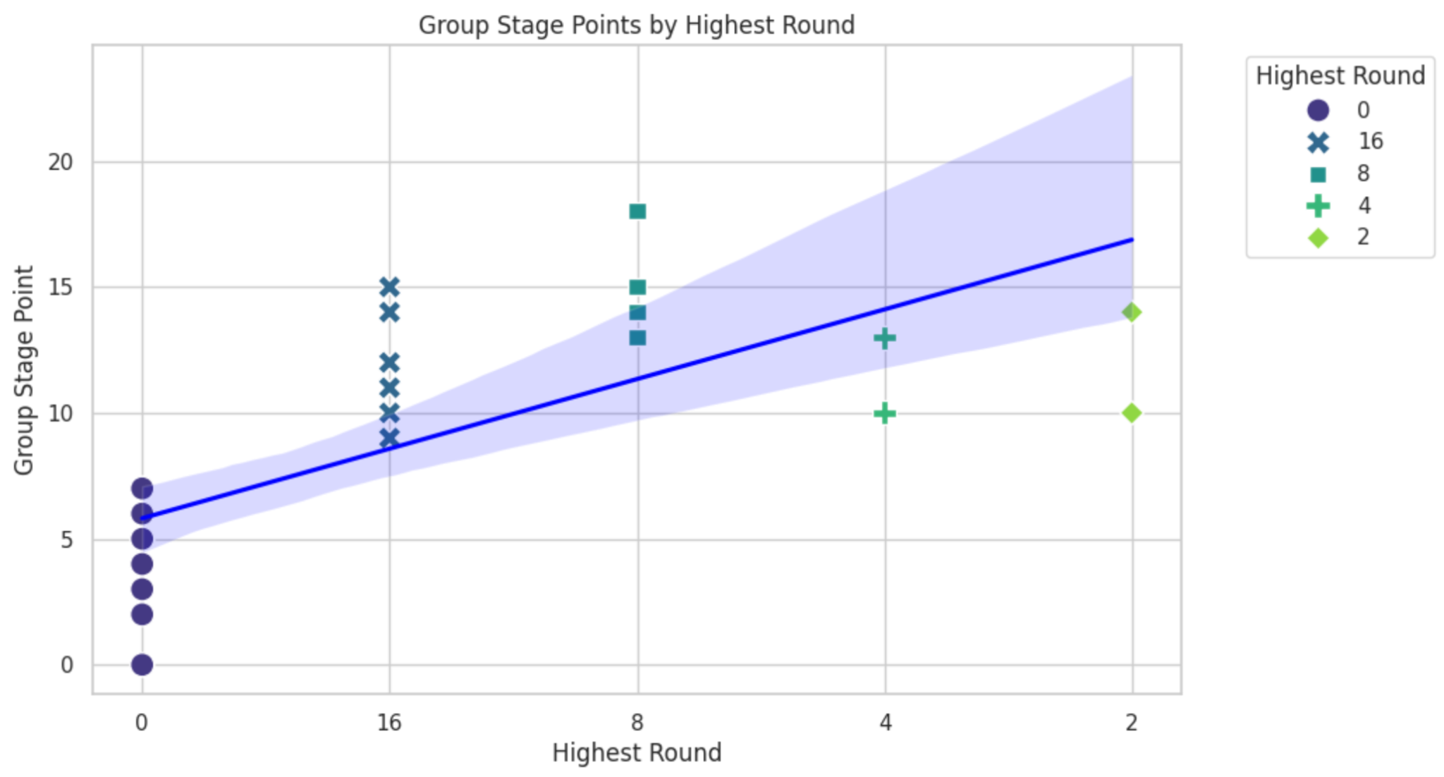
VISUALIZATION

Slide 5
Brief observation from Analysis
Only group stage performance ⇒ Hard to see the relationship
Look at league performance(only the half of the season) and group stage performance together.
3. t-test & ANOVA tables ⇒ Regression models ⇒ Correlation between performance of the first half season and champion

